Slide 1
Dielectic function calculations
11 dec

Slide 2
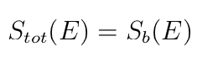
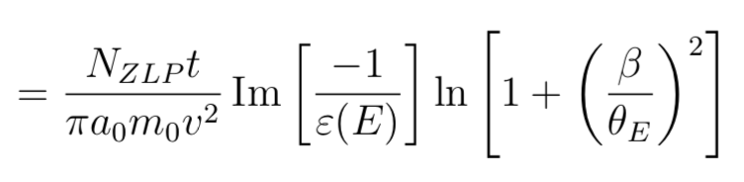
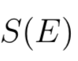
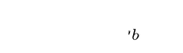
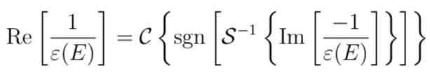
Used formulas recap of last time

Slide 3
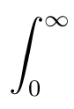
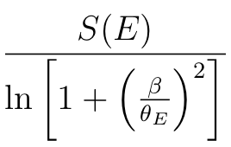
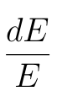
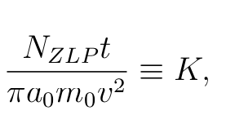
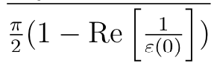

Slide 5
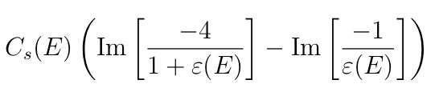
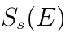
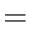
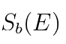
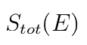
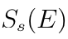
Plan of attack
Assume:
Calculate ε’ with KK-analysis
Calculate
Better approximation:
Calculate ε’’ with KK-analysis
Calculate S_{s}’’
Approximate S_{b}’’’
Calculate ε’’’ with KK-analysis
Calculate S_{s}’’’
Approximate S_{b}’’’’
Repeat until convergence

Slide 6
EELS

Slide 7
First iteration

Slide 9
Next iterations

Slide 10
Equal axis over iterations

Slide 11
No smoothing

Slide 17

Insert a picture

Slide 18

Insert a picture

